Slide 1
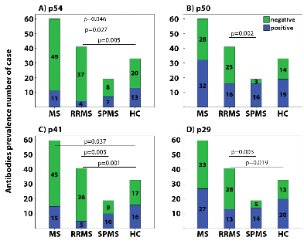
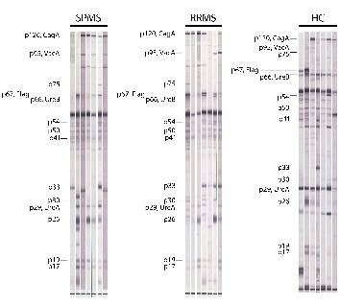
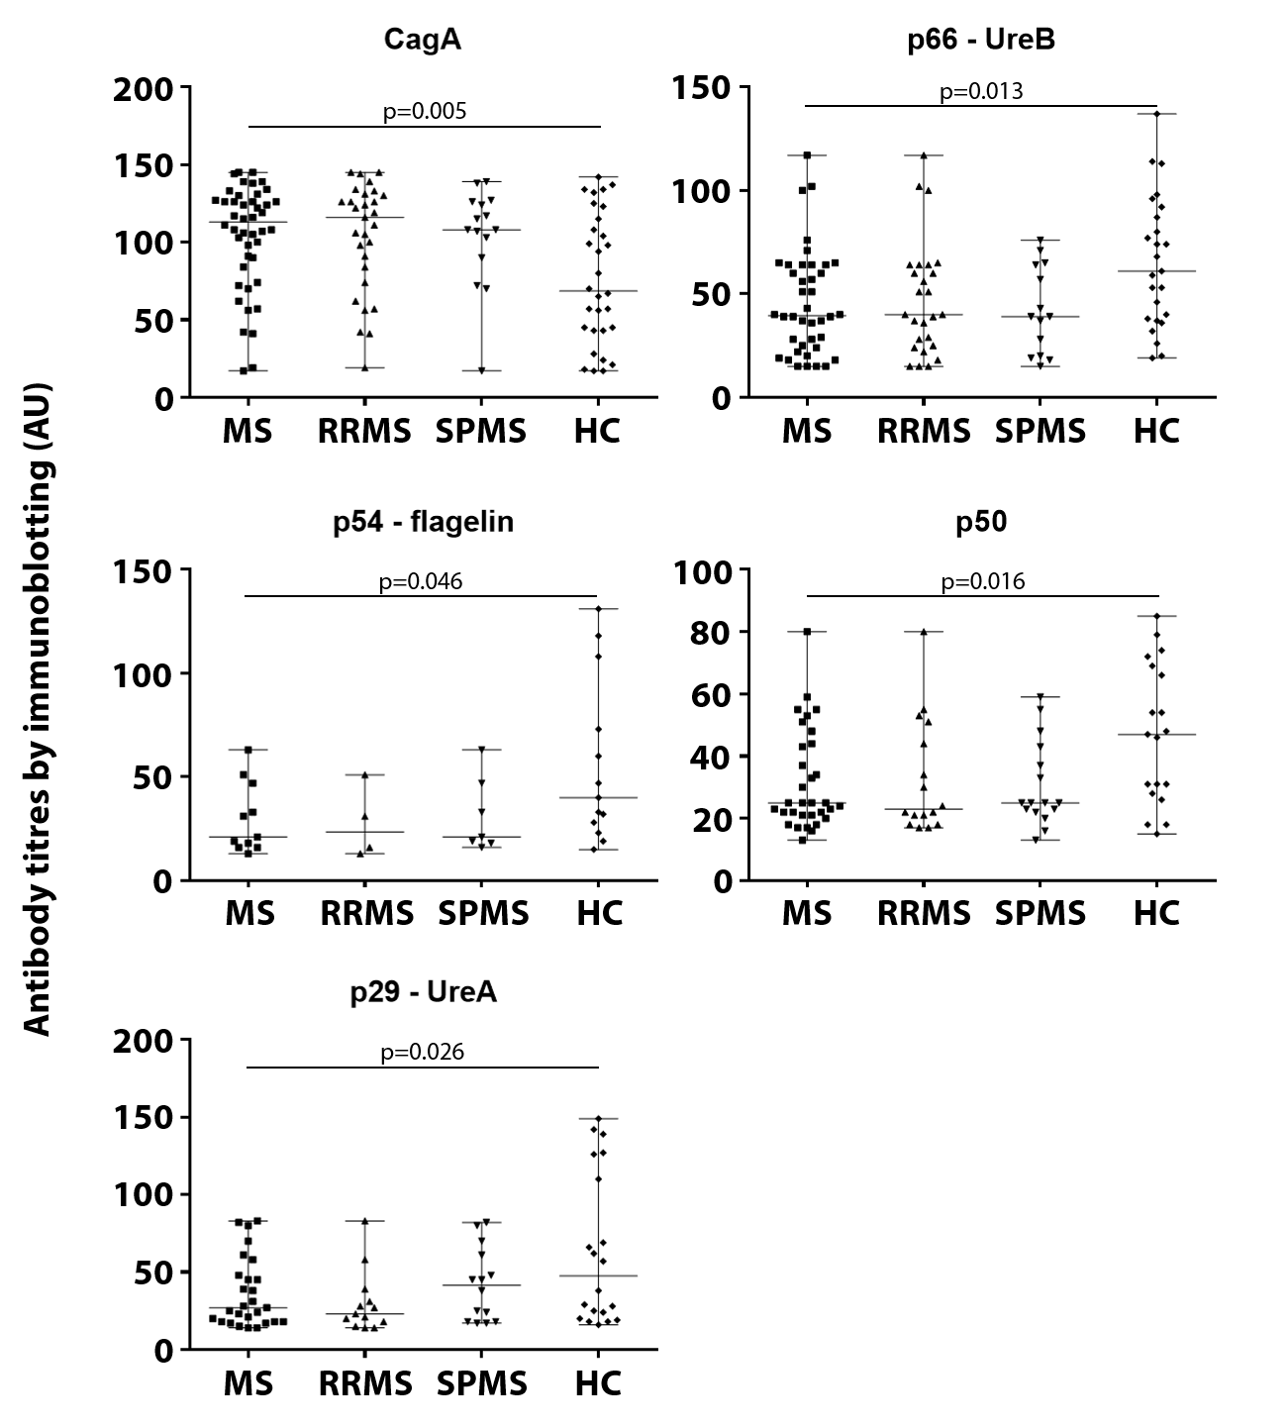
ANTI-HELICOBACTER PYLORI-SPECIFIC ANTIBODIES DIFFERENTIATE RELAPSING REMITTING FROM SECONDARY PROGRESSIVE MULTIPLE SCLEROSIS
G. EFTHYMIOU¹, Z. TSOURIS², C. LIASKOS¹, E. MAROU¹, M. SOKRATOUS², V. TSIMOURTOU², T. SCHEPER³,
W. MEYER³, G. HADJIGEORGIOU², L. I. SAKKAS¹, E. DARDIOTIS², D. P. BOGDANOS¹
¹Department of Rheumatology and Clinical Immunology, University General Hospital of Larissa, Faculty of Medicine, School of Health Sciences, University of Thessaly, Viopolis, Larissa, Greece
²Department of Neurology, University General Hospital of Larissa, Faculty of Medicine, School of Health Sciences, University of Thessaly, Viopolis, Larissa, Greece
³Institute of Experimental Immunology, EUROIMMUN AG, Lübeck, Germany
Introduction
Results (3)
Helicobacter pylori (Hp) has been considered an infectious trigger of MS, but detailed antigen specificity of anti-Hp antibodies (abs) in MS patients with RRMS or SPMS is still lacking. Our aim was to systematically investigate ab reactivity against individual Hp antigens and to assess their clinical relevance.
Figure 2: A) anti-p54-flagelin, B) anti-p50, C) anti-p41 and D) anti-p29-UreA ab prevalence by WB in anti-Hp+ MS patients (n=55), subgrouped in RRMS patients (n=41) and SPMS patients (n=14), and anti-Hp+ HCs (n=42).
Anti-UreA antibody responses correlated with EDSS (p=0.01) and number of relapses (p=0.02); responses to p-30 OMP correlated with age at onset (p=0.03) and the presence of anti-p-19 OMP antibodies tended to be correlated with EDSS (p=0.09) Figure 4).
Materials-Methods
Sera from 139 MS (102 RRMS and 37 SPMS) and 63 matched healthy controls (HCs) were tested. IgG anti-Hp Abs were tested by ELISA. IgG abs to 14 individual Hp antigens were tested by immunoblotting (Figure 1).
Results (2)
The magnitude of anti-CagA was significantly higher in MS compared to HCs (p=0.005). In contrast, the responses against p66-UreB, p54-flagelin, p50 and p29-UreA were less strong in MS compared to HCs (p<0.05 for all) (Figure 3).
Figure 1: Antibody reactivity against Hp antigens by Western immunoblotting in representative RRMS (n=7) patients, SPMS (n=7) patients and HCs (n=7).
Results (1)
Figure 4: Correlations between A) anti-p30 ab reactivity and age at onset, B) anti-p29_UreA and EDSS, C) anti-p29-UreA and number of relapses, D) anti-p19-OMP and EDSS in anti-Hp+ MS patients.
Anti-Hp abs were present in 43.2% MS patients compared to 48.5% HCs (p=ns).
Within anti-Hp positive MS, only CagA tended to be more frequently recognized in MS patients and HCs (p=0.06). In contrast, antibodies against p54-flagelin (p=0.046) and against p41 (p=0.037), were significantly less frequent in MS than HCs. More importantly, four of the 14 anti-Hp antibodies were less prevalent in RRMS patients than in SPMS (Figure 2), namely anti-p50 (p=0.002), anti-p41 (p=0.003), anti-p29-UreA (p=0.005), and anti-p54-flagellin (p=0.027).
Figure 3: Anti-CagA, anti-p66-UreB, anti-p54-flagelin, anti-p50 and anti-p29-UreA antibodies titres by immunoblotting expressed as arbitrary units (AU) in anti-Hp+ MS patients (n=55), subgrouped in RRMS patients (n=41) and SPMS patients (n=14), and anti-Hp+ HCs (n=42). Data represents median with range.
Conclusions
Significant differences in the prevalence and magnitude of responses against Hp antigens is evident between MS and healthy individuals, as well as between RRMS and SPMS, indicating association with this bacterium. Clinical correlations involving responses to anti-UreA may suggest the pathophysiological importance of this antigen in MS.

