Slide 1
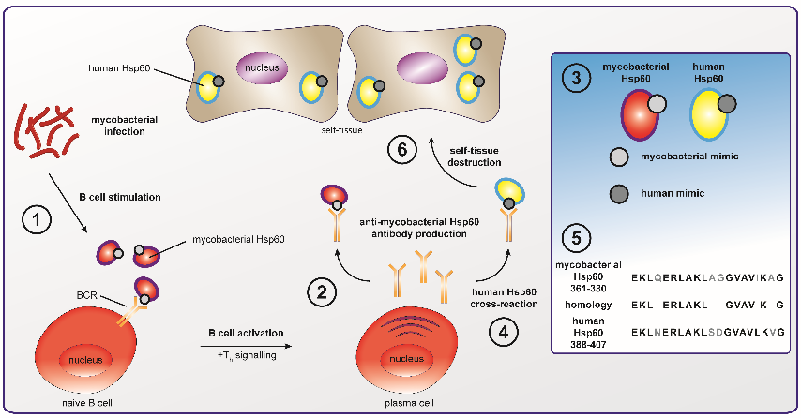
ANTI-HUMAN HSP60 IN AUTOIMMUNE DISEASES
G. EFTHYMIOU, L. I. SAKKAS, D. P. BOGDANOS
Department of Rheumatology and Clinical Immunology, University General Hospital of Larissa,
Faculty of Medicine, School of Health Sciences, University of Thessaly, Viopolis, 40500, Larissa, Greece
Introduction
Autoantibodies against human heat shock protein 60 (Hsp60) have been implicated in the pathogenesis of autoimmune and inflammatory rheumatic diseases (AIRDs), including rheumatoid arthritis (RA), systemic lupus erythematosus (SLE), systemic sclerosis, Sjogren’s syndrome and various idiopathic vasculitides. This literature review discusses research advances in the field.
Materials-Methods
The reference source for this review was PUBMED. The literature search was limited to published, peer-reviewed reports and involved the following search terms, as well as cross-referencing: autoantibody, autoimmunity, Hsp60, inflammation, rheumatic diseases.
Results
Anti-human Hsp60 autoantibodies can be detected in the sera of patients with AIRDs in various frequencies and levels (Table 1); therefore, their diagnostic, clinical and pathogenic importance remains enigmatic. Regarding their clinical significance, several studies have implicated them in AIRDs with vascular manifestations, including SLE and primary vasculitides. For other diseases, however, clinical associations have not been comprehensively investigated. Their pathogenetic role is also questionable, although several studies have suggested an apoptotic capacity of anti-Hsp60 autoantibodies on osteoblasts and endothelial cells, linking them with joint inflammation and bone erosion in RA and vascular inflammation in SLE and vasculitides, respectively. In addition, molecular mimicry based on amino acid similarities between human Hsp60 and bacterial Hsp60 or other bacterial antigens has been implicated in the production of cross-reactive autoantibodies in AIRDS (figure 2), connecting infection with autoimmunity and autoimmune disease.
Disease | Technique | Prevalence | HC prevalence | Other major findings
Rheumatoid arthritis | Immunoblot, ELISA | 5%-20% | 2.8% | Higher titres or no difference compared to HC
Juvenile rheumatoid arthritis | Immunoblot, ELISA | 100% | ND | Higher titres compared to HC
Spondyloarthritis | ELISA | ND | ND | Higher titres compared to HC
Systematic lupus erythematosus | Immunoblot, ELISA | 4.2%-76% | 2.8% | Higher titres or no difference compared to HC
Systemic sclerosis | Immunoblot, ELISA | 6.3%-12.5% | 2.8% | No difference in titres compared to HC
Sjogren’s syndrome | Immunoblot, ELISA | 10%-20% | ND | Lower titres or no difference compared to HC
Wegener’s granulomatosis | Immunoblot, ELISA | 44%-56% | ND | Higher titres compared to HC
Polyarteritis nodosa | Immunoblot, ELISA | 42%-79% | ND | Higher titres compared to HC
Microscopic polyangiitis | Immunoblot, ELISA | 25%-62% | ND | Higher titres compared to HC
Churg-Strauss syndrome | Immunoblot, ELISA | 0%-20% | ND | No difference in titres compared to HC
MPO-ANCA vasculitis | ELISA | ND | ND | Higher titres compared to PR3-ANCA vasculitis and HC
Takayasu’s arteritis | ELISA | 15%-84% | 11%-22% | Higher IgG titres compared to HC
Behçet’s disease | Immunoblot, ELISA | 22%-44% | ND | Higher titres or no difference compared to HC
Polymyositis | Immunoblot, ELISA | 0% | 2.8% | Lower titres compared to HC, but not statistically significant
Figure 1: Molecular mimicry and antibody cross-reaction as potential mechanism of infection-induced anti-human Hsp60 antibodies production. Bacterial infection (1) stimulates the production of anti-bacterial antigen specific antibodies, including anti-bacterial Hsp60 antibodies (2). Molecular mimicry (3) between a bacterial Hsp60 epitope and a human Hsp60 epitope leads to cross-reaction of antibodies (4) that recognize both bacterial and human mimic, via highly sequence-homologous epitopes recognized by autoimmune, disease-specific antibodies (5). Eventually, cross-reactive antibodies mediate self-tissue inflammation and destruction (6).
Table 1: Anti-human Hsp60 immune responses in autoimmune rheumatic diseases. HC, healthy controls. ND, not defined.
Considerations
A consensus on the role of anti-human Hsp60 antibodies in autoimmune rheumatic diseases has not emerged and, thus, more organized investigations of human Hsp60 humoral immune responses are necessary in order to decipher their role in its full extent.

