Slide 1

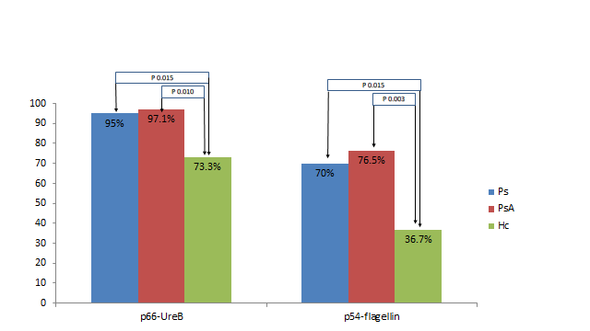
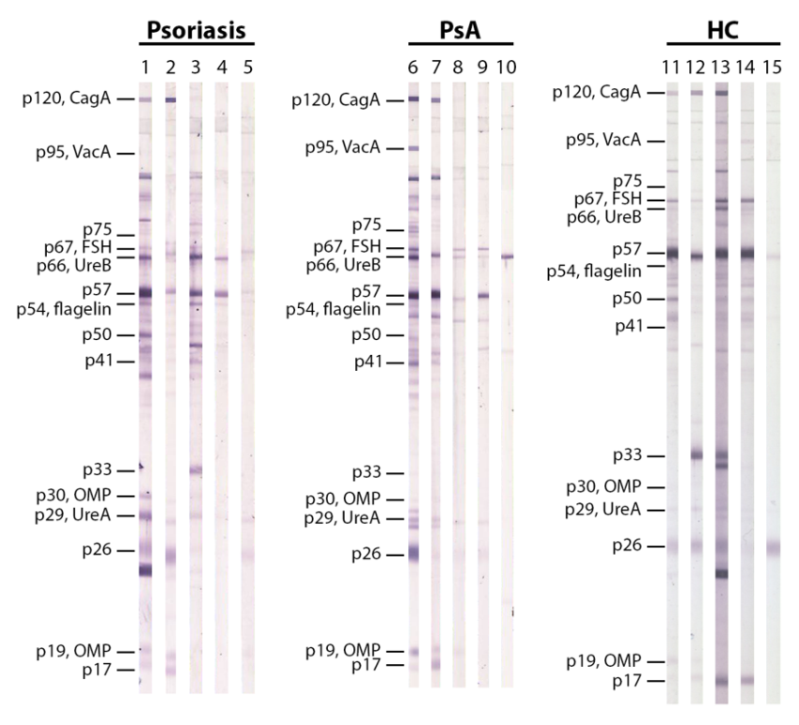
ANTIBODY REACTIVITY AGAINST HELICOBACTER PYLORI ANTIGENS IN PATIENTS WITH PSORIATIC DISEASES
Eleni Patrikiou¹, Christos Liaskos¹, George Efthymiou¹, Niki Ntavari², Efterpi Zafiriou² , Theodora Simopoulou¹, Thomas Scheper³, Wolfgang Meyer³, Aggeliki-Victoria Roussaki-Schulze², Dimitrios P. Bogdanos¹
¹Department of Rheumatology and Clinical Immunology, Faculty of Medicine, School of Health Sciences, University of Thessaly, Larissa, Greece
²Department of Dermatology, Faculty of Medicine, School of Health Sciences, University of Thessaly, Larissa, Greece
³Institute of Immunology, Euroimmun, Lübeck, Germany
CONCLUSION
In patients with psoriatic disease p66-UreB and p50-flagellin was statistically more frequent in psoriatic disease. p50 and the p17 have higher titers in HC versus PsA and Ps respectively, however no correlation of the presence of any anti-H.p antibody with demographic characteristics and disease severity was found.
INTRODUCTION
Psoriasis (Ps) and Psoriatic Arthritis (PsA) are inflammatory diseases with unknown etiology. Helicobacter pylori (Hp) infection is hypothesized as one of the microbial agents that plays a role in the development of the disease.
AIM OF THE STUDY
To detect the specific antibody immune response against 15 different Hp antigens in patients with psoriatic disease. To correlate their frequency in patients with Psoriatic disease versus healthy controls (HCs) and to correlate the detection of anti-Hp antibodies with demographic characteristics and disease severity.
Figure 1: Comparison of percentage of reactivity against p66 and p54 between patients with psoriatic disease and HC.
RESULTS
Positivity against Hp was found in 40 patients (35.1%), with Ps in 34 patients (38.2%) with PsA and in 30 (50%) HC.
Amongst positive patients, abs against anti-p66-UreB abs were more frequent in Ps and in PsA compared to HC (Ps vs Hc P=0.015, PsA vs Hc P=0.010, respectively) and anti-p54-flagellin abs were more frequent in Ps and in PsA compared to HC (Ps vs Hc P=0.011, PsA vs Hc P=0.003, respectively.
Concerning the magnitude of antibody responses, p50 and p17 had higher titers in Hc versus PsA and Ps respectively.
SUBJECTS AND METHODS
IgG anti-Hp ab testing was performed by a combination of immunoblotting and line blotting in 263 serum samples from 114 patients with Ps, 89 with PsA and 60 demographically-matched HCs. More specific, reactivity to CagA and VagA antigen were testing by lineblot. (Euroimmun AG, Lübeck, Germany).
Figure 2: Ab reactivity against H.p antigens by WB in representative patients with Ps, PsA, and HC.

