Slide 1
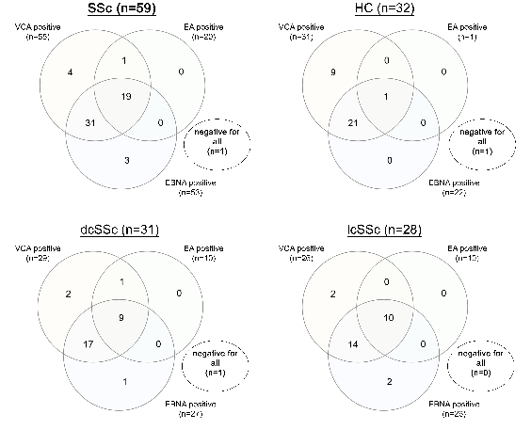
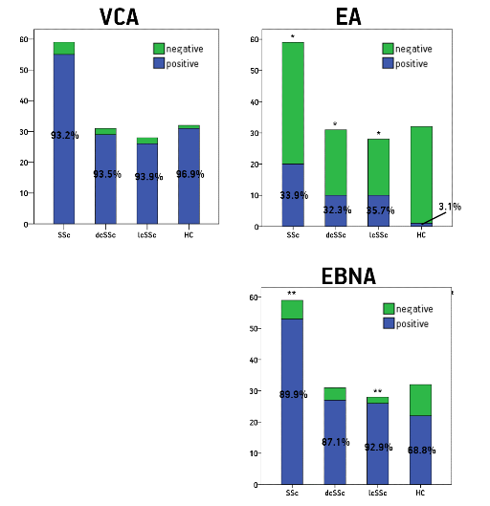
IS THERE ANY ROLE OF EBV
IN SYSTEMIC SCLEROSIS?
G. EFTHYMIOU¹, C. LIASKOS¹, E. MAROU¹, V. TSIMOURTOU² T. SCHEPER³, W. MEYER³,
G. HADJIGEORGIOU², , L. I. SAKKAS¹, E. DARDIOTIS², D. P. BOGDANOS¹
¹Department of Rheumatology and Clinical Immunology, University General Hospital of Larissa, Faculty of Medicine, School of Health Sciences, University of Thessaly, Viopolis, Larissa, Greece
²Department of Neurology, University General Hospital of Larissa, Faculty of Medicine, School of Health Sciences, University of Thessaly, Viopolis, Larissa, Greece
³Institute of Experimental Immunology, EUROIMMUN AG, Lubeck ,Germany
Introduction
Epstein-Barr virus (EBV) infection has been considered trigger of various autoimmune diseases, including systemic sclerosis (SSc). The aim of the current study was to assess ab reactivity against EBV viral capsid antigens (VCA), early antigens (EA) and EBNA-1 in SSc, and investigate their clinical relevance.
Results (2)
Also, triple positivity for all three antigen categories was observed more frequently in SSc, dcSSc and lcSSc compared to HCs (p=0.001, p=0.004 and p=0.001, respectively, Figure 2). Anti- EA was present more frequently in SSc patients with calcinosis compared to those without (p=0.014) and tended to be more frequent in patients with pulmonary fibrosis compared to those without (p=0.071).
Materials-Methods
Sera from 59 SSc patients, including 31 diffuse SSc (dcSSc) and 28 limited SSc (lcSSc), 43 matched multiple sclerosis (MS) as controls and 32 matched healthy controls (HC) were tested for IgG anti-EBV VCA, EA and EBNA-1 abs by immunoblotting, using EBV whole SDS extract as antigen substrate.
Figure 2: Venn charts illustrating anti-VCA, anti-EA and anti-EBNA triple positivity in patients with SSc, subgrouped in dcSSc and lcSSc, and HCs.
Results (1)
Percentages of EA and EBNA-1 reactivities were significantly higher in SSc patients compared to HC (p=0.001 and p=0.012, respectively, Figure 1), but were comparable between SSc and MS. These differences remained when SSc was divided in dcSSc and lcSSc. VCA positivity was comparable between SSc or its two subgroups and MS or HCs.
Figure 1: Anti-VCA, anti-EA and anti-EBNA EBV antibodies frequencies by immunoblotting in patients with SSc (n=59), subgrouped in dcSSc (n=31) and lcSSc (n=28), and healthy HCs (n=32). *, p<0.05. **, p<0.01.
 | SSc | dcSSc | lcSSc | HC | p _{SSc vs HC}
Triple positivity | 32.2% | 29% | 35.7 | 3.1% | <0.01
Conclusions
Antibodies against EBV appear to be more frequent in SSc than in healthy controls, and equally prevalent with MS, a disease known to be associated with anti-EBV antibody responses and a known risk factor for MS. Whether an EBV-specific response is also an initiating trigger of SSc remains to be investigated.

