Slide 1
Idiopathic Inflammatory Myositis associated to malignancy: a single centre experience (the Larissa experience) V.Syrmou, T.Simopoulou, E.Patrikiou, C. Liaskos, N.Ntavari, I.Alexiou, C.Katsiari, D.P. Bogdanos Faculty of Medicine, University of Thessaly University General Hospital of Larissa, Department of Rheumatology and Clinical Immunology, Larissa, Greece
INTRODUCTION
Idiopathic inflammatory myositis (IIM) has been associated to malignancy (cancer-associated myositis, CAM) and non-conventional myositis-related autoantibodies (MrAs) have been interrelated with CAM. The aims of the study were to report our Centre’s experience on CAM and to assess its presumed association with MrAs, based on retrospective testing of an exhaustive number of IIM-related autoantibodies
MATERIALS AND METHODS:
Longitudinal study
We retrospectively reviewed all IIM cases of our Department from 2003 for malignancies: preceding, simultaneous, or following IIM diagnosis
Clinical and laboratory features of CAM cases were documented
Before 2013 IIF was performed in HEP 2 cells and anti-Jo-1 only by ELIZA in the UHL Immunology Lab (data collected from medical notes)
From 2013 IIF and line blot for Myositis related Autoantibody profile (Euroimmun) of 20 antigen-specific reactivities was reviewed
Demographics were collated
Data regarding muscle and skin involvement , ILD , dysphagia were collected

Slide 2
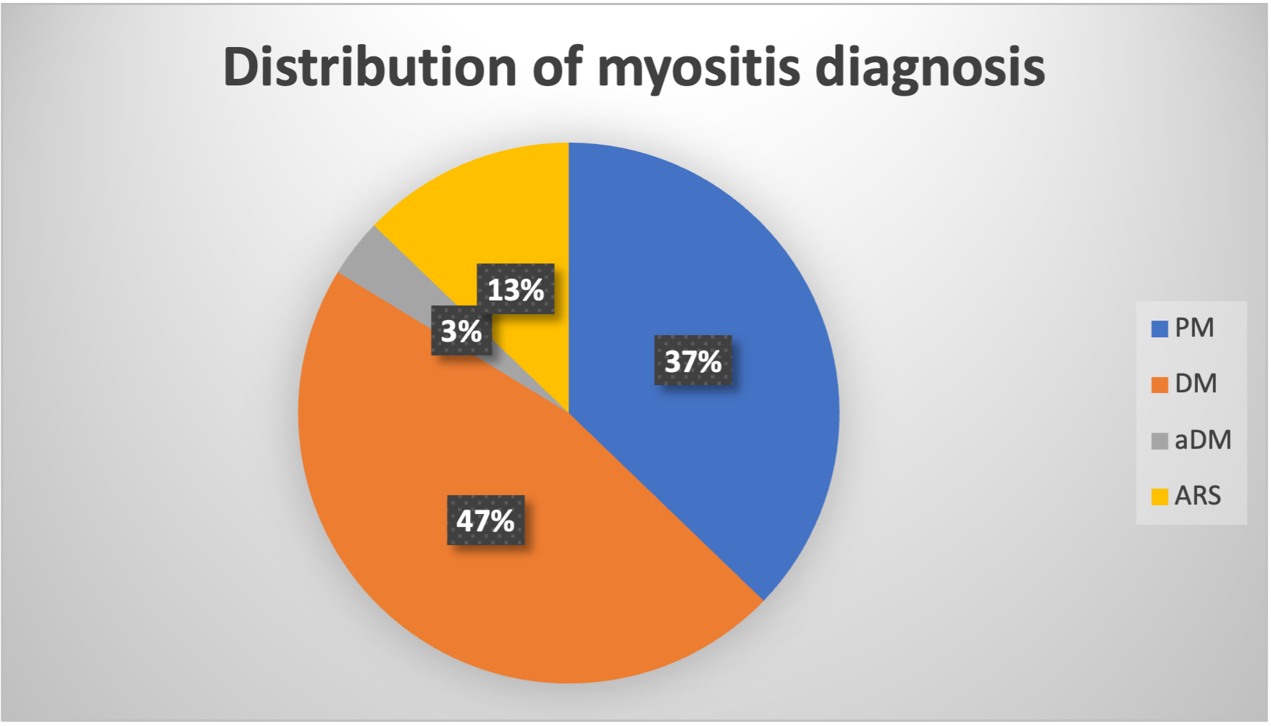
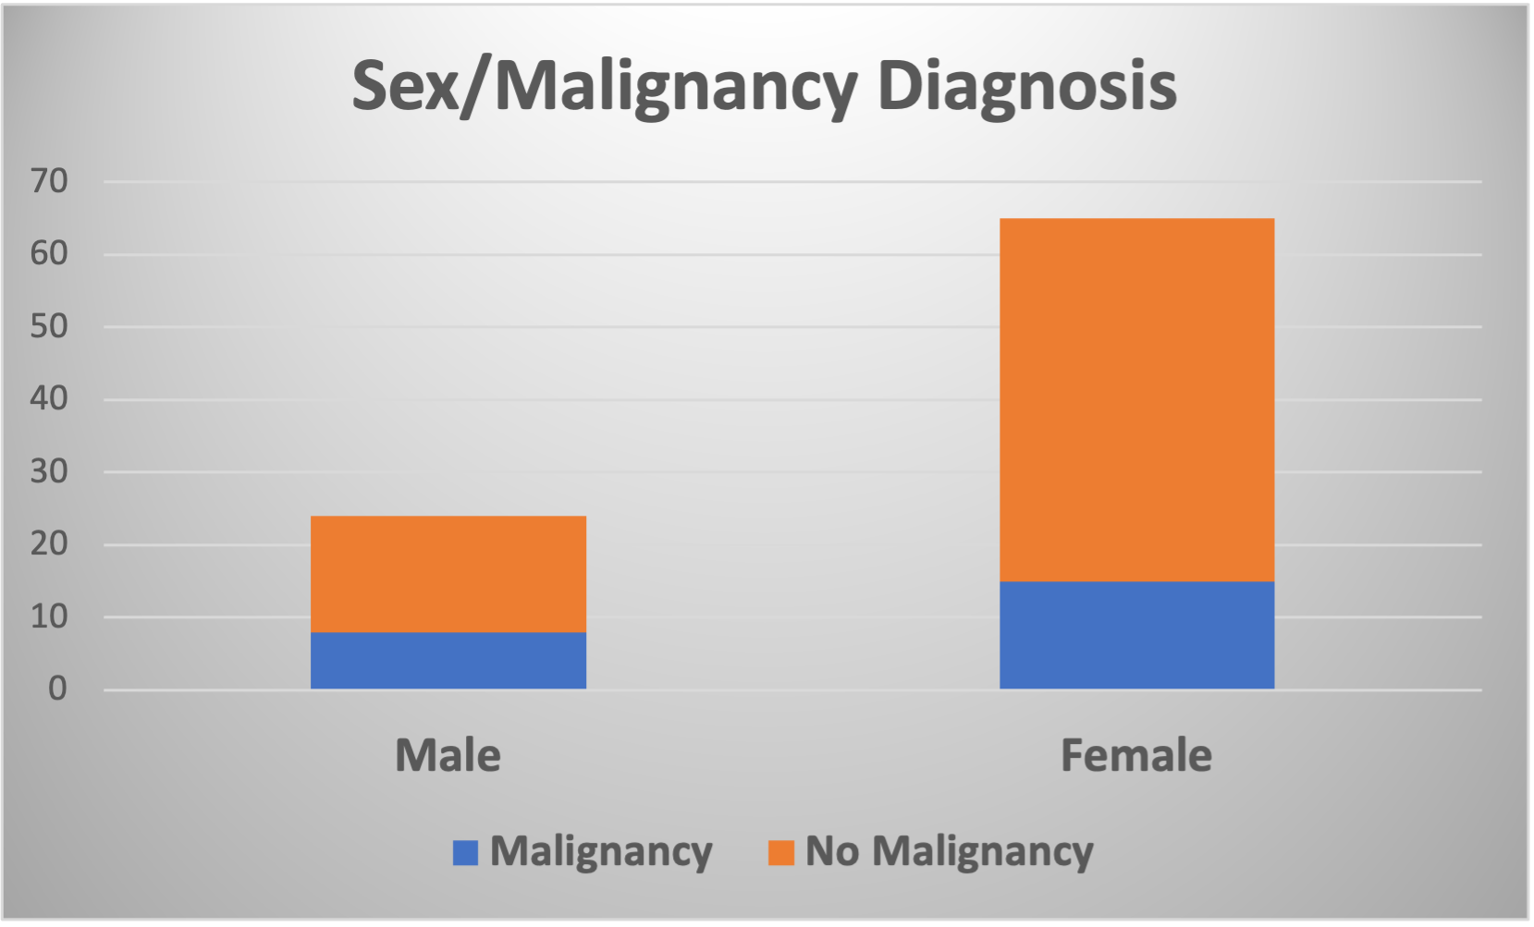
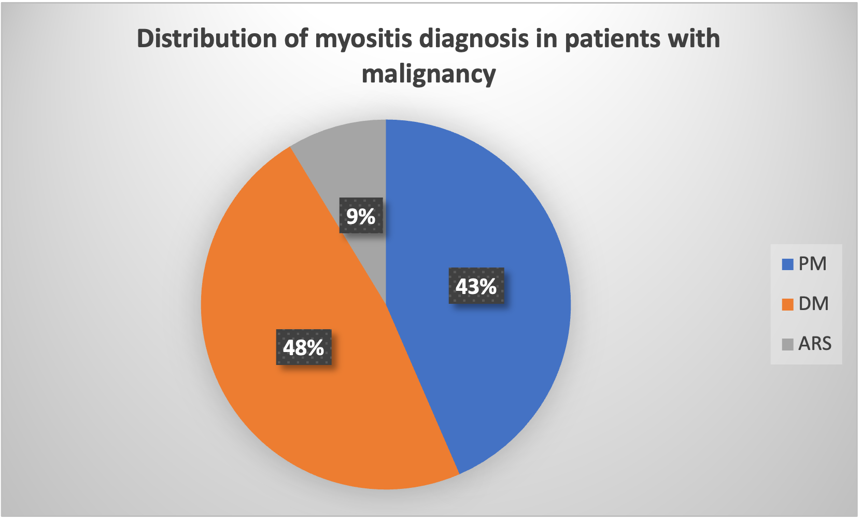
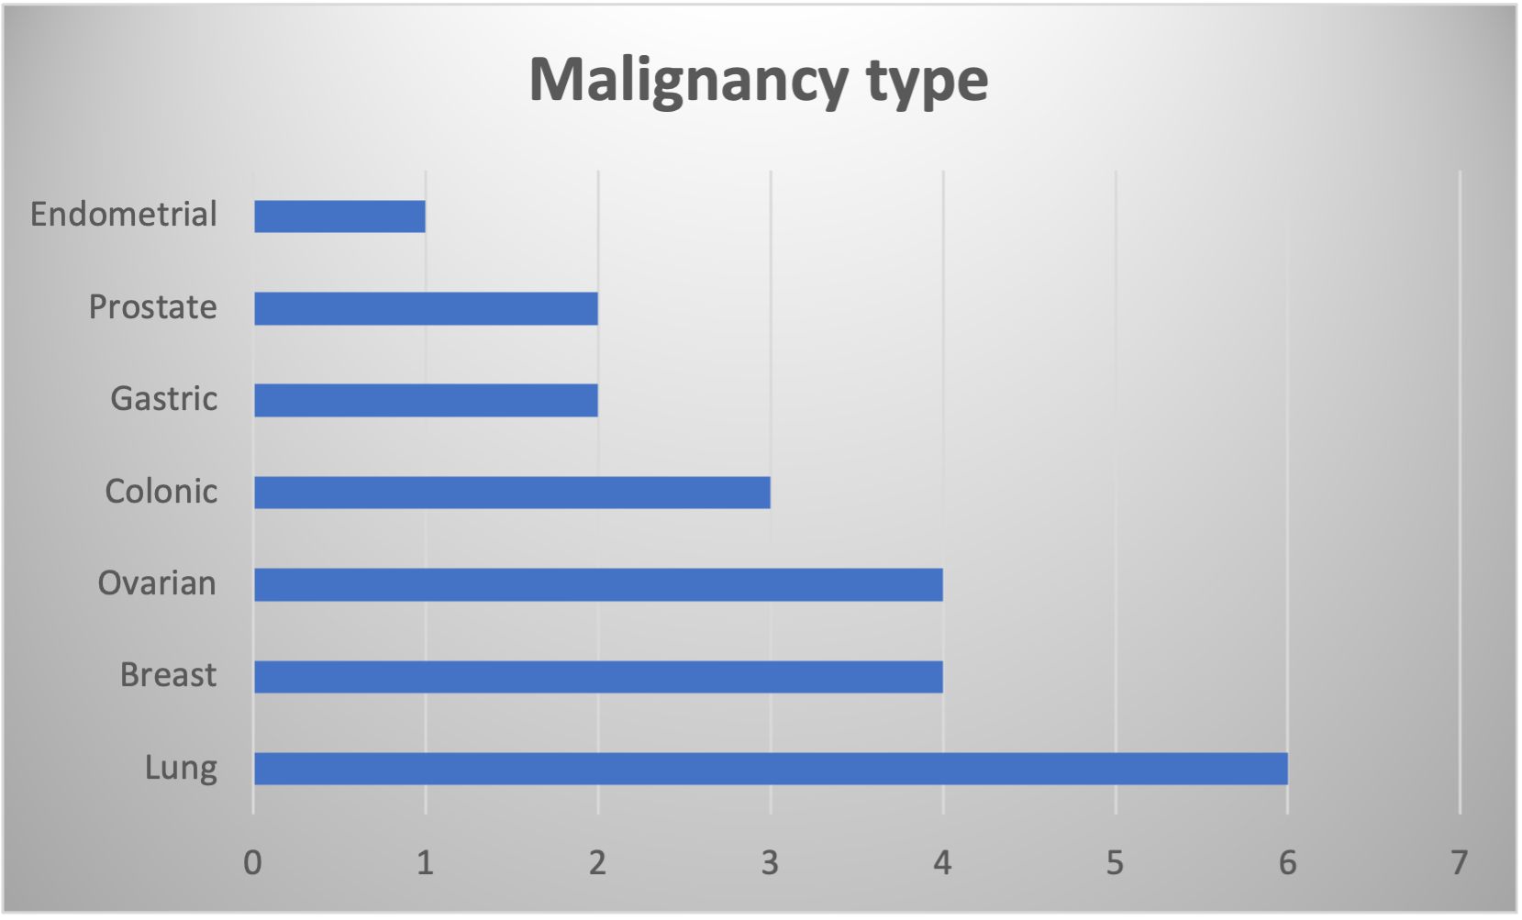
RESULTS
89 cases of IIM ,32 had polymyositis (PM), 40 Dermatomyositis (DM), 3 amyopathic Dermatomyosis (aDM) and 11 Anti-Synthetase syndrome (ARS).
65 female and 24 male patients(F/M=2.7) of which 23 patients (15 females and 8 males) developed 24 cases of malignancy.
Mean age at diagnosis of IIM=66.8 years
In 14 cases (60.8%) malignancy and IIM differed by less than 3 years.
Muscle involvement was observed in 21 patients (91%), skin manifestations in 11 (47 %, Gottron’s sign was the most prevalent) and ILD in 6(26%) patients with malignancy.
Dysphagia was documented in 4 cases (17% vs 7% in the whole group)

Slide 3
Autoantibody profile
Conclusion
CAM is present almost in one fourth of our IIM cases
the most frequent being lung, ovarian and breast cancer
Malignancy is slightly more prevalent in the polymyositis subgroup
malignancy diagnosis does not differ from IIM diagnosis by more than 3 years in more than half of the patients. Muscle is the most prevalent manifestation of CAM
References:
Chen et al (2010) Cancer risks of dermatomyositis and polymyositis: a nationwide cohort study in Taiwan. Arthritis Res Ther. 12(2):R70
Buchbinder R et al (2001) Incidence of malignant disease in biopsy-proven inflammatory myopathy. A population-based cohort study. Ann Intern Med. 134(12):1087
Sigurgeirsson B et al (1992) Risk of cancer in patients with dermatomyositis or polymyositis. A population-based study. N Engl J Med. 1992;326(6):363.
Urbano-Márquez A et al (1991) Polymyositis/dermatomyositis: the current position. Ann Rheum Dis.50(3):191.
Wang J. et al (2013) Meta-analysis of the association of dermatomyositis and polymyositis with cancer Br J Dermatol. 169(4):838-47.

