Slide 1
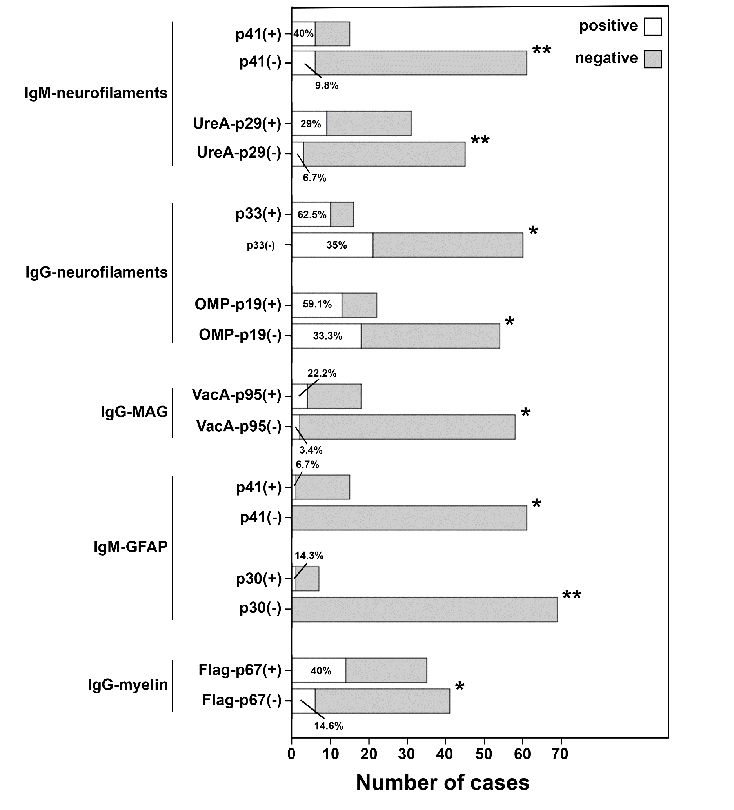
RELATION OF MULTIPLE SCLEROSIS-SPECIFIC AUTOANTIBODIES AND ANTI-HELICOBACTER PYLORI ANTIBODIES IN PATIENTS WITH MULTIPLE SCLEROSIS
G. EFTHYMIOU¹, K. FECHNER², T. SCHEPER², W. MEYER², G. HADJIGEORGIOU³, L. I. SAKKAS¹, E. DARDIOTIS³, D. P. BOGDANOS¹
¹Department of Rheumatology and Clinical Immunology, University General Hospital of Larissa, Faculty of Medicine, School of Health Sciences, University of Thessaly, Viopolis, Larissa, Greece
²Institute of Experimental Immunology, EUROIMMUN AG, Lübeck, Germany
³Department of Neurology, University General Hospital of Larissa, Faculty of Medicine, School of Health Sciences, University of Thessaly, Viopolis, Larissa, Greece
Introduction
Several antibodies against autoantigens have been linked with the pathogenesis of multiple sclerosis (MS)^{1,2}. However, their association with antigen-specific anti-Helicobacter pylori (Hp) antibodies in patients with MS has not been investigated yet. The aim of the current study was to identify potential associations in patients with MS.
Results
When MS patients were grouped according to their reactivity to Hp antigens, autoantibody frequency was higher in the Hp(+) patients compared to the Hp(-) (Figure 1). Anti-neurofilaments IgM antibodies were more frequent in anti-p41(+) (p=0.004) and anti-p29-UreA(+) patients (p=0.009), anti-neurofilaments IgG antibodies were more frequent in anti-p33(+) (p=0.047) and anti-p19-OMP(+) patients (p=0.038), anti-MAG IgM antibodies were more frequent in anti-VacA(+) patients (p=0.010), anti-GFAP IgM antibodies were more frequent in anti-p41(+) (p=0.042) and anti-p67-Flag(+) patients (p=0.002) and anti-myelin IgG antibodies were more frequent in anti-p67-Flag(+) patients (p=0.012).
Materials-Methods
Sera from 76 MS patients were examined for IgG and IgM MS-related autoantibodies by specialized indirect immunofluorescence techniques (including transfected cells) and for IgG Hp antibodies against 15 dominant antigens^{3,4} (Table 1).
MS-related autoantibodies | Hp antigen-specific antibodies (IgG)
MAG IgM/IgG CV2 IgM/IgG Purkinje cells IgM/IgG Myelin IgM/IgG Neurofilaments IgM/IgG Vascular endothelium IgM/IgG GFAP IgM | CagA-p120 VacA-p95 p75 Flag-p67 UreB-p66 Hsp60-p57 p54 p50 p41 p33 p30 p29-UreA p26 p19-OMP p17
Figure 1: : Anti-MS-related autoantibodies frequencies vs anti-Hp-antigen specific antibodies frequencies in patients with multiple sclerosis (n=76). *, p<0.05; **, p<0.01
Table 1: Lists of target antigens of detected MS-related autoantibodies and detected Helicobacter pylori (Hp) specific antigens.
Considerations
MS-related autoantibodies are associated with the variable presence of antibodies against Hp antigens, a finding that requires further investigation in search of a potential pathogenic link..
References
¹ Prineas, J. W. & Parratt, J. D. E. Multiple sclerosis: Serum anti-CNS autoantibodies. Multiple sclerosis 24, 610-622, doi:10.1177/1352458517706037 (2018).
² Riedhammer, C. & Weissert, R. Antigen Presentation, Autoantigens, and Immune Regulation in Multiple Sclerosis and Other Autoimmune Diseases. Frontiers in immunology 6, 322, doi:10.3389/fimmu.2015.00322 (2015).
³ Efthymiou, G. et al. Immune responses against Helicobacter pylori-specific antigens differentiate relapsing remitting from secondary progressive multiple sclerosis. Scientific reports 7, 7929, doi:10.1038/s41598-017-07801-9 (2017).
⁴ Efthymiou, G. et al. Anti-hsp60 antibody responses based on Helicobacter pylori in patients with multiple sclerosis: (ir)Relevance to disease pathogenesis. Journal of neuroimmunology 298, 19-23, doi:10.1016/j.jneuroim.2016.06.009 (2016).

