Slide 1
VITAMIN D LEVELS AND THROMBOTIC MARKERS IN HOSPITALIZED PATIENTS WITH SARS-CoV-2 INFECTION
*Kostoglou-Athanassiou Ifigenia* (1), Athanassiou Lambros (2), Nikolakopoulou Sofia (3), Konstantinou Alexandra (3), Mascha Olga (4), Bliziotis Ioannis (3), Samaras Charilaos (3), Athanassiou Panagiotis (5)
(1) Department of Endocrinology, Asclepeion Hospital, Voula, Athens, Greece
(2) Department of Rheumatology, Asclepeion Hospital, Voula, Athens, Greece
(3) COVID-19 Department, Asclepeion Hospital, Voula, Athens, Greece
(4) Department of Biochemistry, Asclepeion Hospital, Voula, Athens, Greece
(5) Department of Rheumatology, St. Paul’s Hospital, Thessaloniki, Greece

Slide 2
Introduction Aim
Severe infection from the SARS-CoV-2 virus is associated with various manifestations, including hematological manifestations. Thrombotic events or a tendency to develop thrombotic events also characterize severe COVID-19 disease and may be related to fatalities. Vitamin D is known to have immunomodulating properties, to enhance the body defense system against invading pathogens and to have immunostimulatory properties as far as the innate immune response is concerned.
The aim of the study was to measure 25(OH)D₃ levels in patients hospitalized for severe COVID-19 infection and to investigate the relationship between 25(OH)D₃ levels and ferritin levels and d-dimer levels.

Slide 3
Methods Results
In a cohort of 42 patients hospitalized for severe infection from the SARS-CoV-2 virus 25(OH)D₃ levels were measured. In the same cohort ferritin levels and d-dimer levels were also measured. Observations were also performed in a control group.
25(OH)D₃ levels were 8.08±1.48 ng/ml (mean±SEM) and they were inversely related to ferritin levels, correlation coefficient -0.15, p=0.001, linear regression analysis and to d-dimer levels, correlation coefficient -0.34, p<0.001, linear regression analysis.

Slide 4
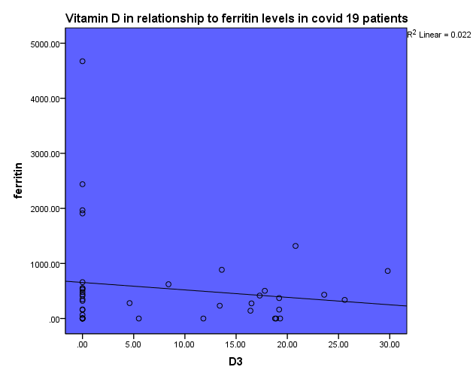
Results

Slide 5
Conclusions References
Severe infection from the SARS-CoV-2 virus is related to a tendency for the development of thrombotic events. D-dimer levels are measured and followed up in these patients. Ferritin levels are also increased in severe SARS-CoV-2 infection and may be related to adverse outcome. We showed that vitamin D levels are low in hospitalized patients with severe SARS-CoV-2 infection and are inversely related to ferritin and d-dimer levels. It may thus be proposed that vitamin D is an inverse index of severity in the context of SARS-CoV-2 infection.
Cooper ID, Crofts CAP, DiNicolantonio JJ, Malhotra A, Elliott B, Kyriakidou Y, Brookler KH. Relationships between hyperinsulinaemia, magnesium, vitamin D, thrombosis and COVID-19: rationale for clinical management. Open Heart. 2020 Sep;7(2):e001356.
Rhodes JM, Subramanian S, Laird E, Griffin G, Kenny RA. Perspective: Vitamin D deficiency and COVID-19 severity - plausibly linked by latitude, ethnicity, impacts on cytokines, ACE2 and thrombosis. J Intern Med. 2021 Jan;289(1):97-115.
Mercola J, Grant WB, Wagner CL. Evidence Regarding Vitamin D and Risk of COVID-19 and Its Severity. Nutrients. 2020 Oct 31;12(11):3361.
Ali N. Role of vitamin D in preventing of COVID-19 infection, progression and severity. J Infect Public Health. 2020 Oct;13(10):1373-1380.

